Slide 1
Take Flight: Using Drones to Get Rural Middle School Girls Interested in STEM Careers
Broadening Participation in STEM for Rural Girls
Notes:
Project Page: https://www.cast.org/our-work/projects/take-flight-drones-rural-middle-school-girls-stem-careers

Slide 2
Overview
Take Flight is building awareness around STEM occupations for female students in middle school Science and CTE (Career and Technical Education) classrooms.
The Take Flight project emphasizes communal goals, and works to dispel the concept of who belongs in STEM, by broadening the ideas around what STEM skills are.
For female students in rural communities, this means shifting how conversations, careers and learning around STEM skills take place; challenging stereotypes and social constructs, and broadening the way rural students and educators view, talk about, and connect to STEM.

Slide 3
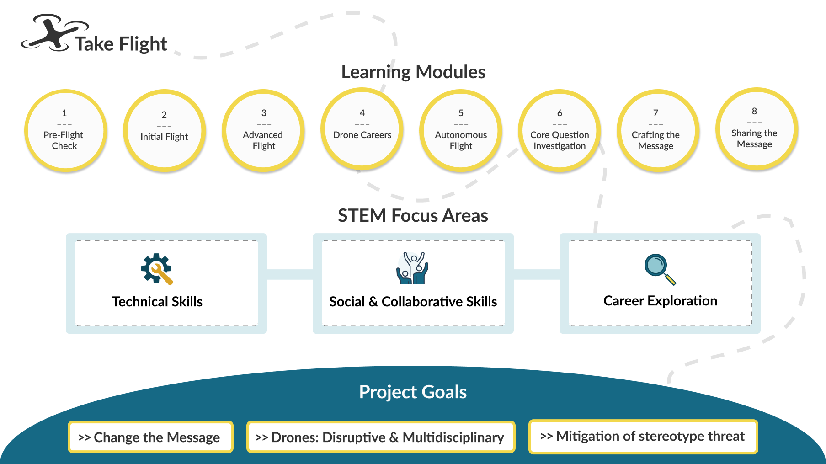
Overview (visual mapping)

Slide 4
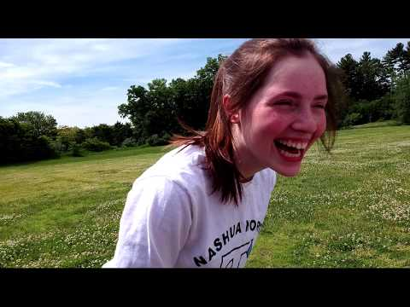
Background: Where did this idea come from?

Slide 5
Values in STEM
Two types of fundamental values embedded within most cultures:
Communal value is the extent to which a task is other-oriented (i.e., involves working with or helping others and creates opportunity for intimate bonds)
Agentic value is the extent to which a task provides autonomy, power, prestige or wealth (Pohlmann 2001).
Communion is embedded within female (and typically western) gender norms and
agency within male (typically western) gender norms (e.g., Eagly et al. 2000) and as
a cause or consequence, there is a large robust finding that men prefer working with
‘‘things’’ and women prefer working with ‘‘people’’ (see the meta analyses by Su
et al. 2009).”

Slide 6
Recruitment
Notes:
This is the overarching question we will pose to students. The curriculum will teach them why this is important and what the barriers are through the use of drones. Then in the end we will ask students to share the message in whatever way makes sense to them as a class or a small group.

Slide 7
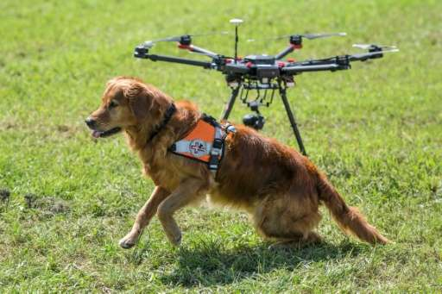
Recruitment School Partners & Community Interviews
School Partners: Schools in NH & ME middle school CTE/Science classes that would be interested in hearing about the project, receiving the equipment and training
Community Interviews: Professionals in New England (or similar rural areas ) using drones in their careers, looking for a diverse range of professionals from a variety of backgrounds, with a focus on female STEM professionals

Slide 8
Curriculum
Notes:
This is the overarching question we will pose to students. The curriculum will teach them why this is important and what the barriers are through the use of drones. Then in the end we will ask students to share the message in whatever way makes sense to them as a class or a small group.
How do we broaden participation in STEM?

Slide 9
Main Objectives
Change the message. To increase the motivation of female students to pursue STEM goals in rural communities, messages about STEM must be delivered in new ways to include communal goals, specifically those that are collaborative and/or altruistic.
Use the disruptive and multidisciplinary mechanism of drones. Drones are not just disruptive. They have the multidisciplinary ability to reshape STEM industries by design and application. They lend themselves to breaking stereotypes and promoting communal goals and, thus, are the perfect “vehicle” for delivering a new message about STEM identity.
Deliver the new message using strengths-based approaches. Learning contexts must be designed to engage female students, mitigate stereotype threat, and leverage students’ assets.

Slide 10
How can you help more people consider a career in STEM?
Notes:
This is the overarching question we will pose to students. The curriculum will teach them why this is important and what the barriers are through the use of drones. Then in the end we will ask students to share the message in whatever way makes sense to them as a class or a small group.

