Slide 1
LEARNING/
KNOWLEDGE
BEING
DOING/
SKILLS
Workshops
Near-peer
Mentor
Project
STEM/ENERGY
‘SCHOLAR’
Aware of energy transition tech & policy
Connects with students based on similar background and identity
SOCIAL EMOTIONAL
LEARNER
Feels connected to school team and community
AGENT
Confident in STEM learning
Models and sparks STEM passion, identity and career aspirations
INTERDISCIPLINARY LEARNER
Thinks across disciplinary divides
CONTRIBUTOR
Gains civic experience (contributing to school and community)
SYSTEMS THINKER
Accounts for interrelationships within systems
Tutors students in knowledge, skills and learning approaches
PERSPECTIVE TAKER
Understands
stakeholder
perspectives; negotiates
Models behavior, persistence, learning process, joy of discovery
MATHEMATICAL THINKER
Knows model parameters, inputs, outputs
PROJECT-BASED
LEARNER
Builds project implementation skills
Shows a path forward
(a common story)
OPTIMIST
Hopeful for future
PROBLEM SOLVER
Authentic work met a need
Knowledge, Skills, Self-Awareness, Connection
Identifies as ready, capable and interested in contributing to the energy transition through a STEM career
Empowered as a 21st Century Energy Leader

Slide 2
Fig 2. Theory of Change: Steps of change toward STEM/energy careers for each activity. Colors demonstrates possible enhancement of impact of near-peer mentoring on workshops and project-based learning.
Fig. 2 Example En-ROADS simulation output illustrating variables students manipulate during simulation

Slide 3
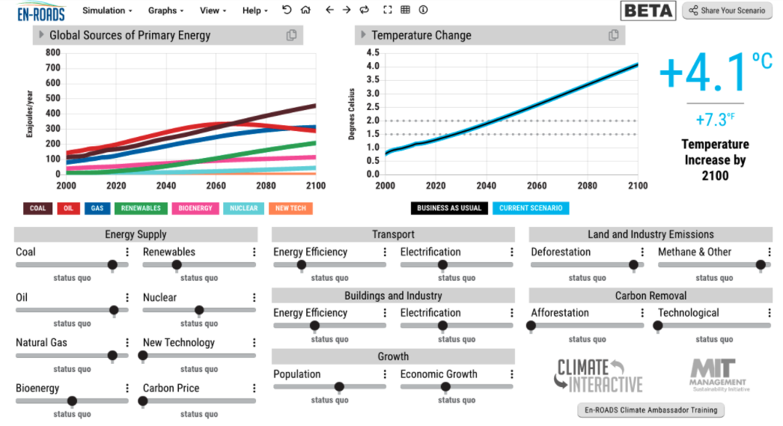
Fig. 1 Example En-ROADS simulation output illustrating variables students manipulate during simulation

